Slide 1
Securing IoT Devices on our networks
Eliot Lear
Principal Engineer
31 Oct 2018

Slide 2
Why is IoT different?

Slide 3
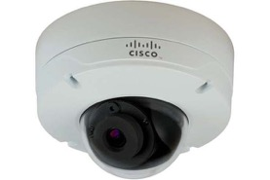
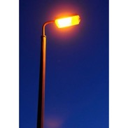
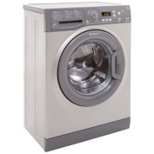
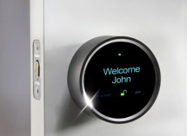
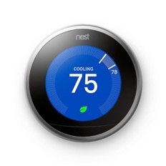
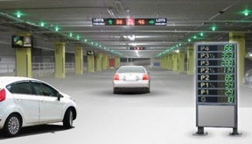
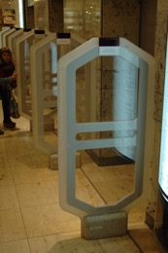
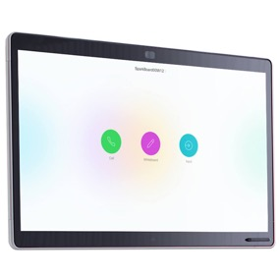
What’s the scope of the problem?

Slide 4
Questions that need answering
What is the device’s identity? Does this particular thing belong on the network?
What type of thing is it?
What is this thing?
Who is responsible for it?
If something breaks, who should be called?
What access does it need?
With which devices should it communicate?
Is it doing what it should be doing?
With which devices is it actually communicating?
Is it behaving as designed?
Notes:
Eliot – Added AVC to the last bullet point

Slide 5
Steps needed to get a device to join a network
Out of the box
Device learns which network to join
Provision device to trust network
Provision network to trust device
Operational State

Slide 6
Design goal choices
Correct network selection
Proof of ownership
Supply chain security

Slide 7
Basic concept: a voucher
module: ietf-voucher
yang-data voucher-artifact:
+---- voucher
+---- created-on yang:date-and-time
+---- expires-on? yang:date-and-time
+---- assertion enumeration
+---- serial-number string
+---- idevid-issuer? binary
+---- pinned-domain-cert binary
+---- domain-cert-revocation-checks? boolean
+---- nonce? binary
+---- last-renewal-date? yang:date-and-time

Slide 8
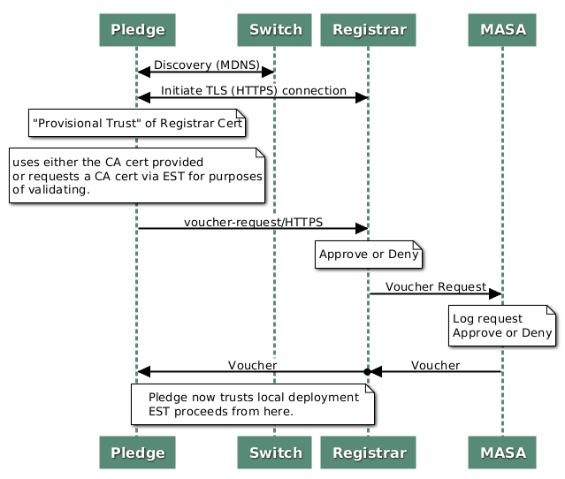
Bootstrapping with wired (ANIMA BRSKI)
Pledge=Device
Registrar=Store of known devices (tied to AAA infrastructure)
MASA=”Manufacturer Authorized Signing Authority”
EST -enrollment over secure transport

Slide 9
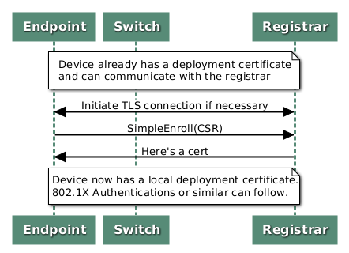
Client gets a certificate via EST

Slide 10
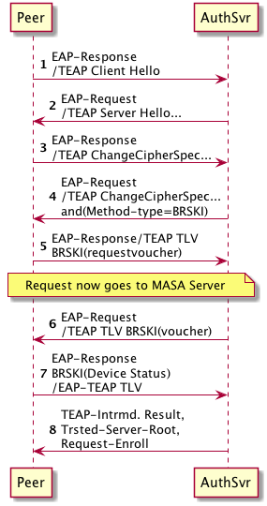
Getting there with wireless
Can do EAP-Success here if we recognize local cert
Use existing management path in the network: EAP
Keep onboarding capabilities in interface “bring up”
Reuse as much as possible
Can skip BRSKI and go right to enroll if we need to re-enroll

Slide 11
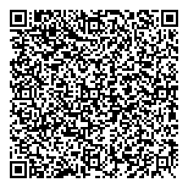
MASA tests proof of ownership
1. Label scanned in
Registrar
3. Proof of ownership included
Thing
2. Normal voucher request
MASA

Slide 12
Thing tests proof of ownership
1. Label scanned in
Registrar
3. Proof of ownership included
Thing
2. Normal voucher request
MASA

Slide 13
No MASA
1. Label scanned in
Registrar
2. Voucher request
Thing
3. Proof of ownership included

Slide 14
Approaches to onboarding
 | WPS | Simple Serial # | DPP | BRSKI w/ sales integration | BRSKI no sales integration | BRSKI with POP
Correct Network Selection | Yes | Yes | Yes | Yes | No | Yes
Onboard without Internet access | Yes | Yes | Yes | No | No | Yes
Proof of ownership | No | No | No | Yes | Yes** | Yes***
Supply chain security | No | No | No | Yes | Yes*** | Partial
Hands free* | No | No | No | Yes | Yes | No
Well secured | No | Maybe | Yes | Yes | Yes | Yes
Status | Here | Not planned | Std | Partially standardized | Partially standardized | Beginning
Key type | None | Ser # | Asym. | X.509 | X.509 | X.509 + private
Manufacturing complexity | Nvram | Serial# | Public Key + label/BOM | Cert+Back End Integration | Cert | Cert+label/BOM
*Hands free = no label or BOM integration
**Assumes protection of proof of ownership
***Assumes Internet access to enterprise AAA at some point

Slide 15
Lines of complexity
Certs
Device
WPA-2/EAP
Asymmetric Keys
Back end sales integration
Manufacturing
Labels
Deployment Complexity

Slide 16
Drafts
draft-ietf-anima-bootstrapping-keyinfra-16 (core draft)
draft-friel-anima-brski-over-802dot11-01 (some options)
draft-lear-eap-teap-brski-01 (BRSKI over EAP)
draft-lear-brski-pop-00 (proof of possession)

